Slide 1
Leader Roundtable Connect to Purpose
Melissa Matarazzo, Leader Coach
December 1, 2020
Notes:
Welcome, introductions, agenda for the day, use phone if needed for breakout rooms

Slide 2
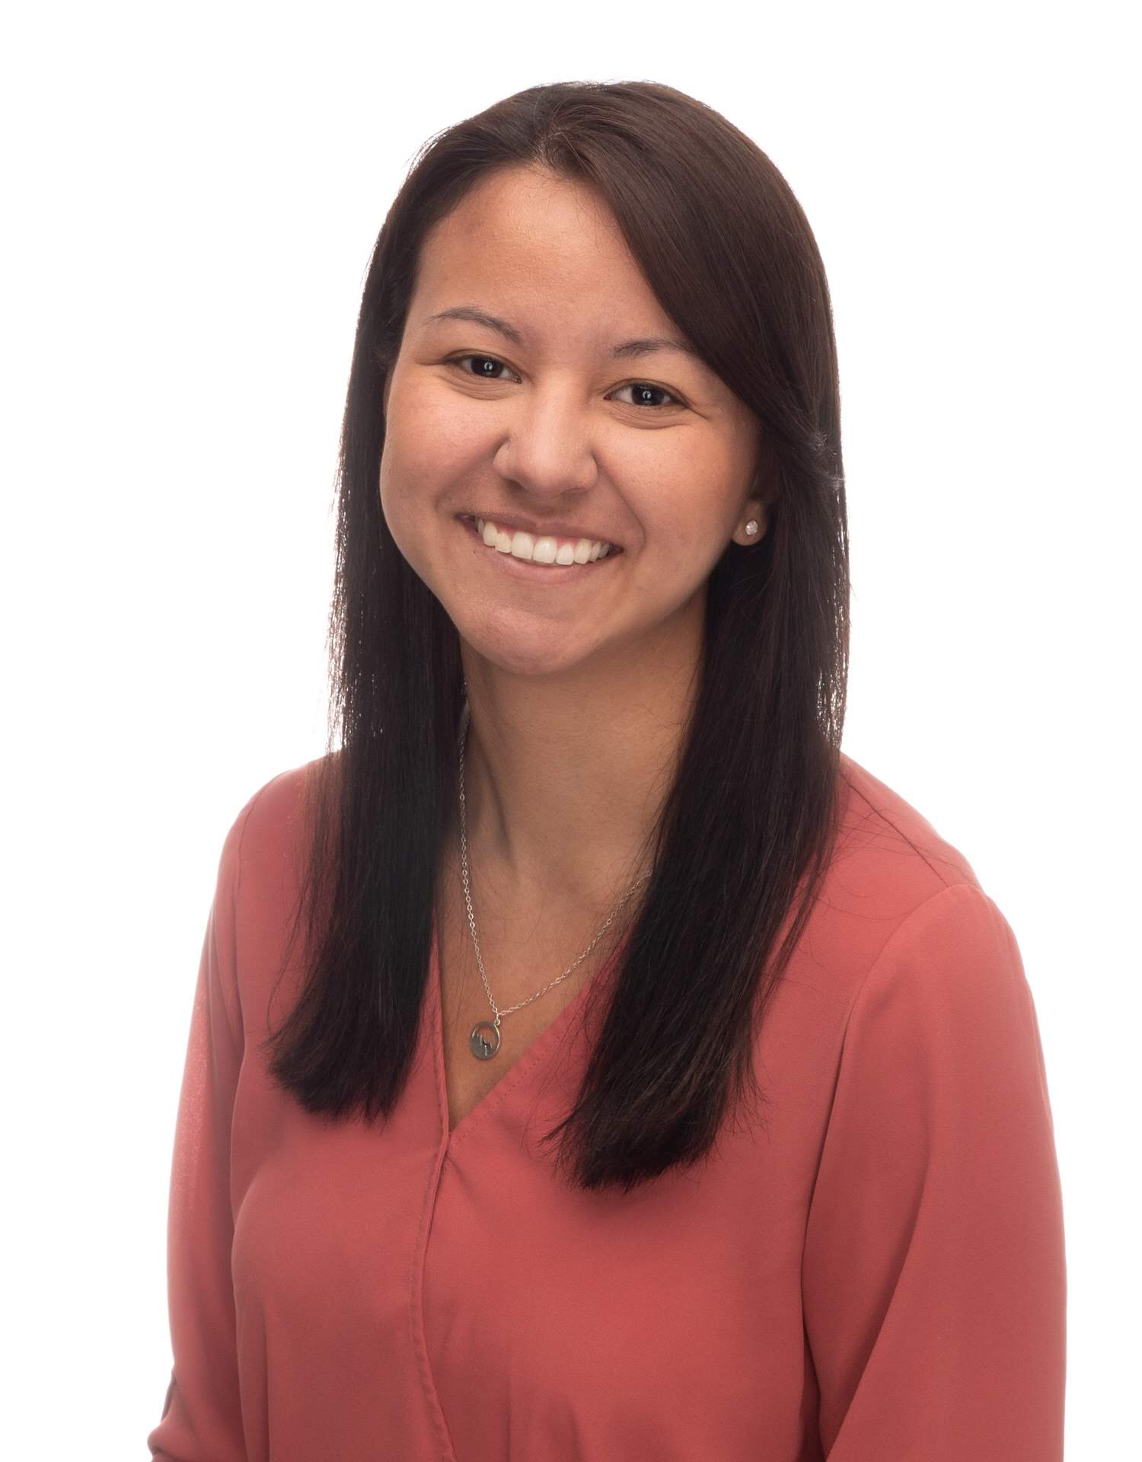
BEKA PADILLA Content and Resource Support Studer Education
Connect with BEKA
rebekah.padilla@studereducation.com

Slide 3
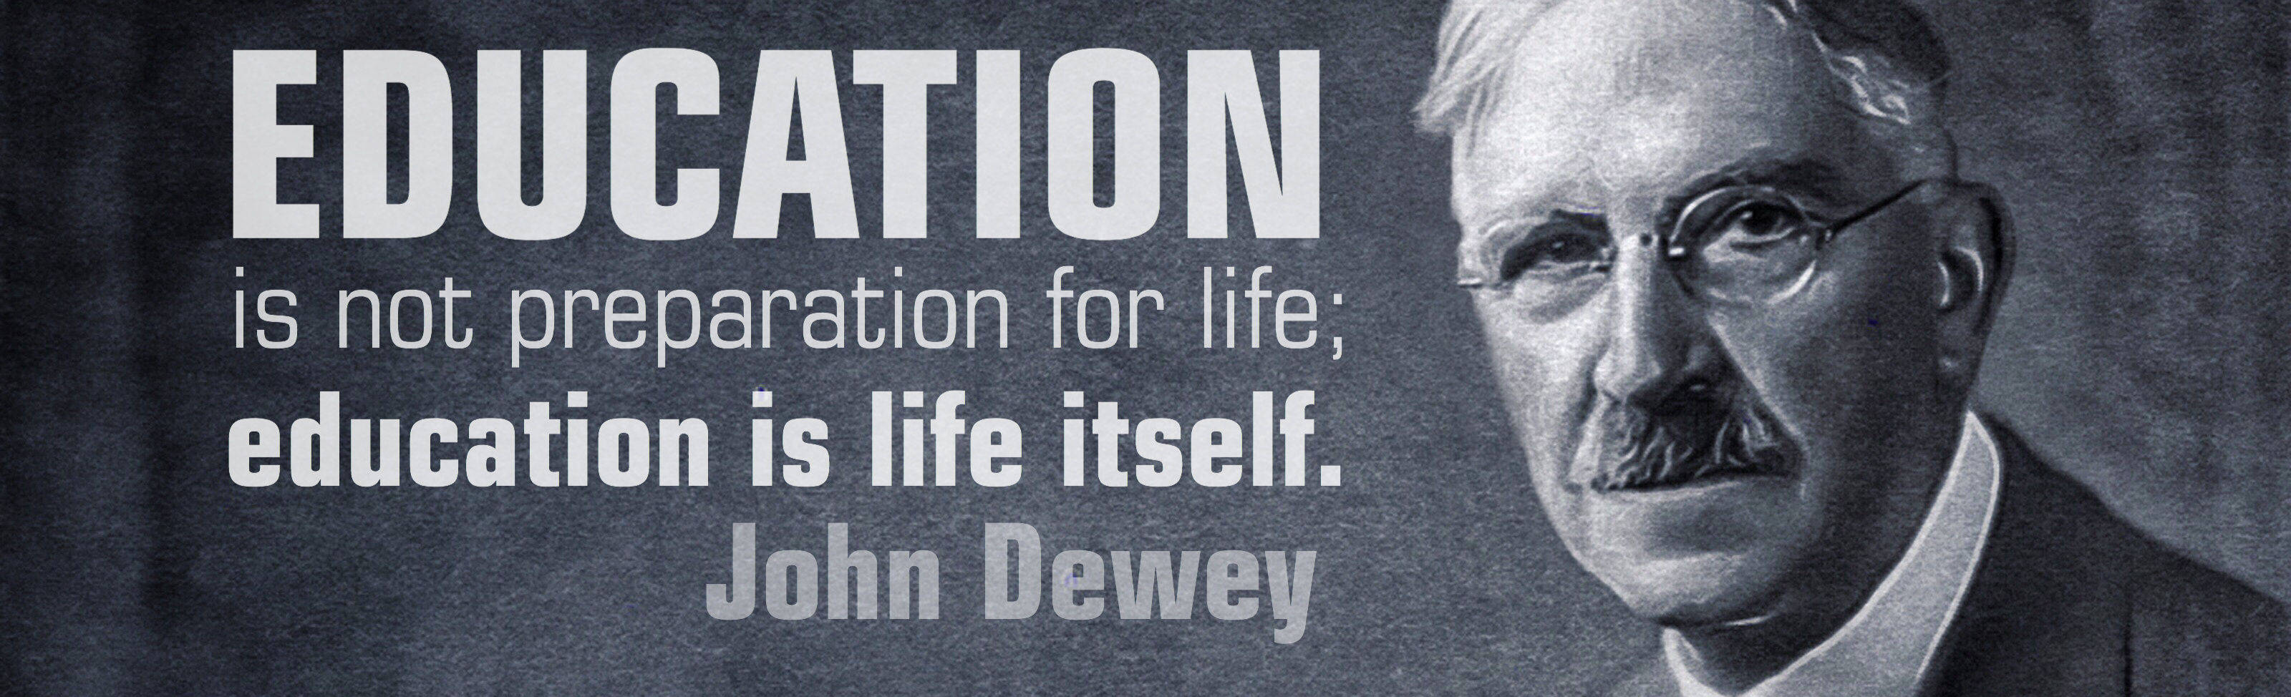
Connect To Purpose is:
An intentional
story or reflection
that reminds people
of their collective purpose

Slide 4
Poll
How consistently do you begin activities with a Connect to Purpose?
0-25%
25-50%
50-75%
75-100%

Slide 6
“Leadership is both an art and a science. Therefore, as we seek to hardwire excellence and create high-performance cultures, we need to be able to connect to people on two levels: heart and mind.”
— Quint Studer

Slide 7
Direct the Rider
Motivate the Elephant
Shape the Path

Slide 8
A Great Connect to Purpose
Can be visual, verbal, audio, video, or text-based
When spoken, communicates with intentional tone, pace, and choice of words
Highlights organizational values or communicates about progress toward a goal
Reflects your personal journey and individual motivation
Tells a compelling story
Activates emotions and reflection in the listeners
Lays the foundation for meaningful engagement in the activity to follow
Connect to Purpose, www.9principles.com

Slide 9
“Story, as it turns out, was crucial to our evolution -- more so than opposable thumbs. Opposable thumbs let us hang on; story told us what to hang on to.” -LISA CRON, AUTHOR OF WIRED FOR STORY

Slide 10
Storytelling Tips
Don’t try to make yourself the hero. Make the audience or someone else the hero, if possible.
Use your own experiences. Be vulnerable.
Be authentic, don’t skip over the struggle. Only focusing on the positive experiences will come off as fake.
Keep it simple, emotional details are important, but the day of the week probably isn’t. Focus on the details that help you convey the core message.
Always consider your audience before developing a story.
Keep a bank of stories that demonstrate company values, standards, norms, acceptable behaviors, and culture of the organization.
The Power of Storytelling, www.9principles.com

Slide 11
Poll
In which format are you most likely to share a Connect to Purpose?
Photo/image
Quote
Video
Song
Story

Slide 12
Sample

Slide 13
Connect to Purpose: Leadership Freak/ Chip Bell
Sample
Begin with the stories you want others telling about your leadership. What do you want your teammates saying about you to their family and friends?
What’s important to you about those stories? Do you want them saying you’re decisive, kind, a good listener, or inspiring? Why do you care?
Practice behaviors that create the stories you want others telling about you. How might you listen in such a way that your team members go home and say, “I can’t believe how well my boss listens to me,” for example?

Slide 14
Reflect
Sample
“The root of the word Courage is cor—the Latin word for heart….Ordinary courage is about putting our vulnerability on the line…Integrity is choosing courage over comfort; it’s choosing what’s right over what’s fun, fast, or easy; and it’s practicing your values, not just professing them.”
– Brene Brown
Where is this me, today? What change leadership is requiring my courage, today?

Slide 15
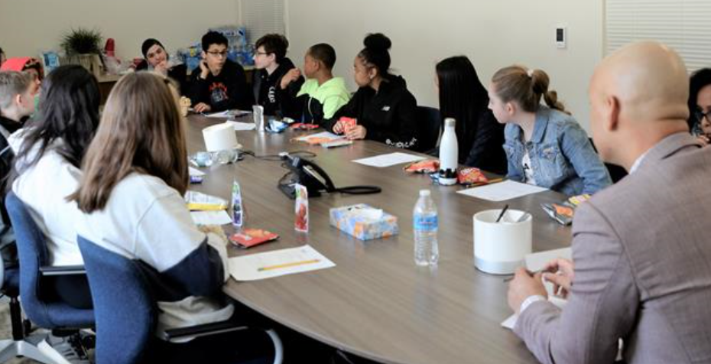
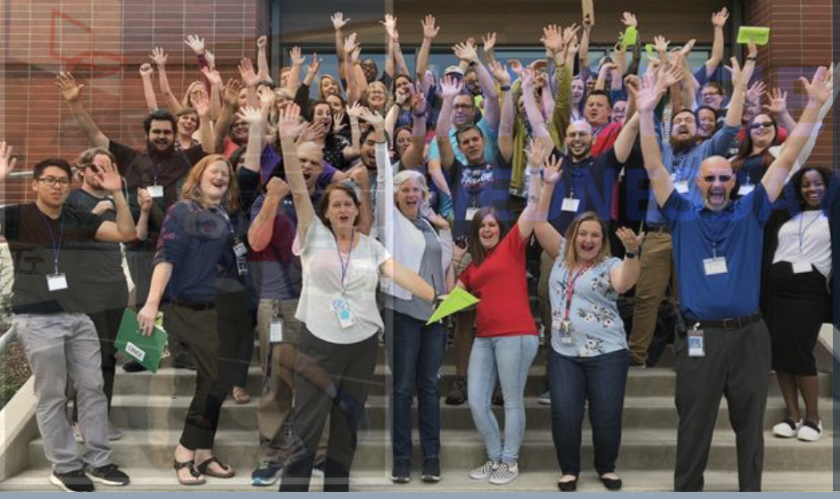
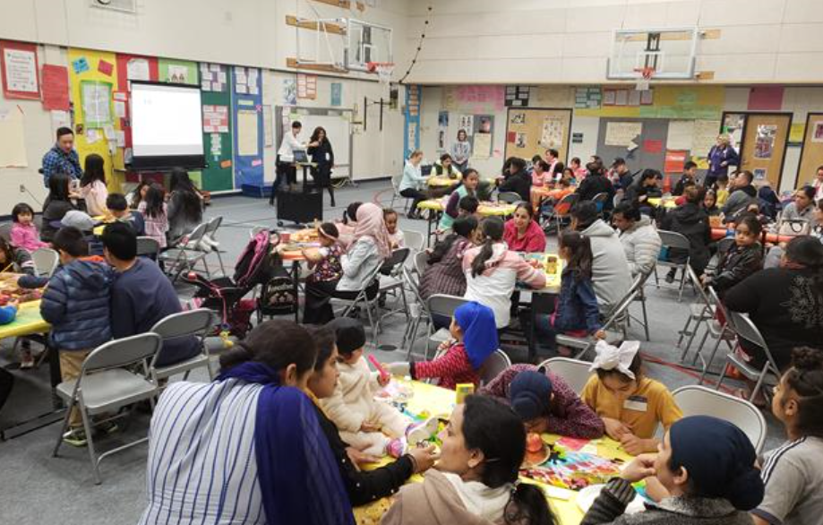
Our Service to Students, Staff, Parents
Sample

Slide 16
Breakout Leader Discussion
In the past week, what’s 1 Connect to Purpose that you have gathered? If it’s not a full story, it can be a vignette, a moment, an image, a meme.
Practice telling a new Connect to Purpose story to your breakout group. You can gather more stories this way!
Who is a leader that you work with who does a great job of Connecting to Purpose? How do they do it?

Slide 17
Discussion summary
This Photo by Unknown Author is licensed under CC BY-SA-NC
Notes:
Coaches share out their highlights from facilitated discussions in breakout rooms

Slide 18
Leaders are more powerful role models when they learn than when they teach.
-Rosabeth Moss Kanter

Slide 19
LEADER ROUNDTABLES
Mark your calendars to set aside 60 minutes to log in, learn from a leadership coach and discuss what matters right now with education and community leaders across the country.
Tuesday, December 8 | 2 p.m. CT
Reward and Recognition: Connecting to Mission and Values
with Leader Coach JoAnn Sternke
Effective leaders highlight the impact of employee contributions, connecting recognition to fulfilling the mission and values of our organization. Learn how, as a leader, you can apply reward and recognition tactics that will sustain your team’s motivation to give their best every day.
Tuesday, December 15 | 2 p.m. CT
Vulnerability and Leadership
with Leader Coach Janet Pilcher
Vulnerable leaders create ways to let others in their heads and hearts, especially in difficult situations. People want leaders to have the courage to say when something is not working. What do vulnerable leaders do when having to share bad news?
REGISTER: studereducation.com/events
Notes:
Additional roundtables each week at 2:00 Central Time. We’d love your feedback on the time/weekday of these leader discussions. Our goal is to have them work for you and be helpful to you as you learn from each other during execution of reentry.

